Slide 1



Noida Institute of Engineering and Technology, Greater Noida
Knowledge Representation & Expert System
Unit: 04
Knowledge representation
Course Details
(B Tech 3rd Sem)
Alka Singh
Assistant Professor
B.Tech AIML
Alka Singh ACSAI-301 AI Unit 04

Slide 2
Knowledge Representation
Humans are best at understanding, reasoning, and interpreting knowledge. Human knows things, which is knowledge and as per their knowledge they perform various actions in the real world. But how machines do all these things comes under knowledge representation and reasoning. Hence we can describe Knowledge representation as following:
Knowledge representation and reasoning (KR, KRR) is the part of Artificial intelligence which concerned with AI agents thinking and how thinking contributes to intelligent behavior of agents.
Alka Singh ACSAI-301 AI Unit 04

Slide 3
It is responsible for representing information about the real world so that a computer can understand and can utilize this knowledge to solve the complex real world problems such as diagnosis a medical condition or communicating with humans in natural language.
It is also a way which describes how we can represent knowledge in artificial intelligence. Knowledge representation is not just storing data into some database, but it also enables an intelligent machine to learn from that knowledge and experiences so that it can behave intelligently like a human.
Alka Singh ACSAI-301 AI Unit 04

Slide 4
What to represent?
Following are the kind of knowledge which needs to be represented in AI systems:
Object: All the facts about objects in our world domain. E.g., Guitars contains strings, trumpets are brass instruments.
Events: Events are the actions which occur in our world.
Performance: It describe behavior which involves knowledge about how to do things.
Meta-knowledge: It is knowledge about what we know.
Facts: Facts are the truths about the real world and what we represent.
Knowledge-Base: The central component of the knowledge-based agents is the knowledge base. It is represented as KB. The Knowledge base is a group of the Sentences (Here, sentences are used as a technical term and not identical with the English language).
Alka Singh ACSAI-301 AI Unit 04

Slide 5
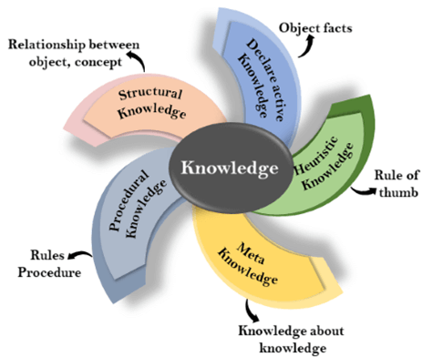
Types of Knowledge
Following are the various types of knowledge:
Alka Singh ACSAI-301 AI Unit 04

Slide 6
Declarative Knowledge:
Declarative knowledge is to know about something.
It includes concepts, facts, and objects.
It is also called descriptive knowledge and expressed in declarative sentences.
It is simpler than procedural language.
Alka Singh ACSAI-301 AI Unit 04

Slide 7
2. Procedural Knowledge:
It is also known as imperative knowledge.
Procedural knowledge is a type of knowledge which is responsible for knowing how to do something.
It can be directly applied to any task.
It includes rules, strategies, procedures, agendas, etc.
Procedural knowledge depends on the task on which it can be applied.
Alka Singh ACSAI-301 AI Unit 04

Slide 8
3. Meta-knowledge:
Knowledge about the other types of knowledge is called Meta-knowledge.
4. Heuristic knowledge:
Heuristic knowledge is representing knowledge of some experts in a filed or subject.
Heuristic knowledge is rules of thumb based on previous experiences, awareness of approaches, and which are good to work but not guaranteed.
Alka Singh ACSAI-301 AI Unit 04

Slide 9
5. Structural knowledge:
Structural knowledge is basic knowledge to problem-solving.
It describes relationships between various concepts such as kind of, part of, and grouping of something.
It describes the relationship that exists between concepts or objects.
Alka Singh ACSAI-301 AI Unit 04

Slide 10
Semantic networks
Semantic networks are alternative of predicate logic for knowledge representation. In Semantic networks, we can represent our knowledge in the form of graphical networks. This network consists of nodes representing objects and arcs which describe the relationship between those objects. Semantic networks can categorize the object in different forms and can also link those objects. Semantic networks are easy to understand and can be easily extended.
This representation consists of mainly two types of relations:
a) IS-A relation (Inheritance)
b) Kind-of-relation
Alka Singh ACSAI-301 AI Unit 04

Slide 11
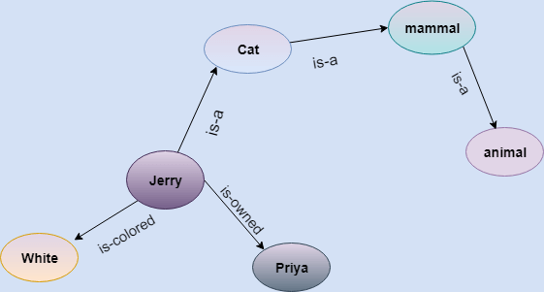
Example: Following are some statements which we need to represent in the form of nodes and arcs.
Statements:
Jerry is a cat.
Jerry is a mammal
Jerry is owned by Priya.
Jerry is brown colored.
All Mammals are animal.
In the above diagram, we have represented the different type of knowledge in the form of nodes and arcs. Each object is connected with another object by some relation.
Alka Singh ACSAI-301 AI Unit 04

Slide 12
Drawbacks in Semantic representation
Semantic networks take more computational time at runtime as we need to traverse the complete network tree to answer some questions. It might be possible in the worst-case scenario that after traversing the entire tree, we find that the solution does not exist in this network.
Semantic networks try to model human-like memory (Which has 1015 neurons and links) to store the information, but in practice, it is not possible to build such a vast semantic network.
These types of representations are inadequate as they do not have any equivalent quantifier, e.g., for all, for some, none, etc.
Semantic networks do not have any standard definition for the link names.
These networks are not intelligent and depend on the creator of the system.
Alka Singh ACSAI-301 AI Unit 04

Slide 13
Advantages of Semantic network
Semantic networks are a natural representation of knowledge.
Semantic networks convey meaning in a transparent manner.
These networks are simple and easily understandable.
Alka Singh ACSAI-301 AI Unit 04

Slide 14
Partitioned Networks
Partitioned Semantic Networks allows to represent difference between description of individual object or process and description of set of objects. The set of description involves quantification.
It breaks network into spaces which consists of groups of nodes and arcs and regard each space as a node.
Partition of semantic network makes semantic network logically more adequate.
Alka Singh ACSAI-301 AI Unit 04

Slide 15
How to represent:
Create a general statement ‘GS’ this is special case.
Make node ‘g’ as instance of ‘GS’.
Every element have two attributes.
  A form that states which relation is being asserted.
  For all ‘∀’ and ∃ connections that represents universally quantified variables and sentences
Alka Singh ACSAI-301 AI Unit 04

Slide 16
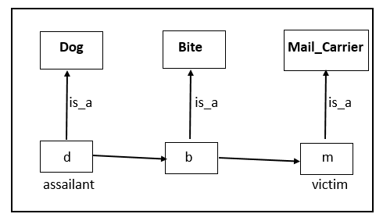
Example
Ques. Draw Partitioned Semantic network for –
The dog bite the mail carrier.
Alka Singh ACSAI-301 AI Unit 04

Slide 17
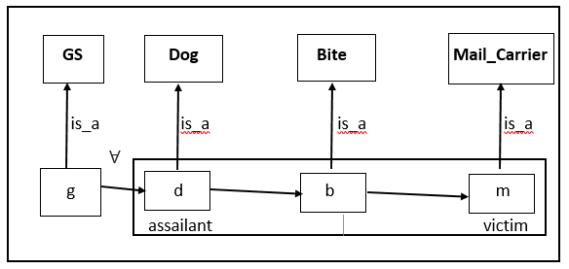
Example
Ques. Draw Partitioned Semantic network for –
Every dog has bitten a mail carrier.
Alka Singh ACSAI-301 AI Unit 04

Slide 18
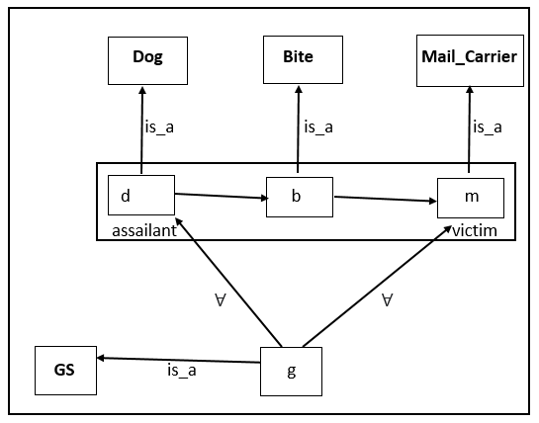
Example
Ques. Draw Partitioned Semantic network for –
Every dog in town has bitten every mail carrier.
Alka Singh ACSAI-301 AI Unit 04

Slide 19
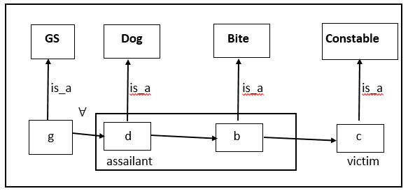
Example
Ques. Draw Partitioned Semantic network for –
Every dog has bitten the constable.
Alka Singh ACSAI-301 AI Unit 04

Slide 20
What are frames?
A frame is a record like structure which consists of a collection of attributes and its values to describe an entity in the world. Frames are the AI data structure which divides knowledge into substructures by representing stereotypes situations. It consists of a collection of slots and slot values. These slots may be of any type and sizes. Slots have names and values which are called facets.
Facets: The various aspects of a slot is known as Facets. Facets are features of frames which enable us to put constraints on the frames. A frame may consist of any number
Alka Singh ACSAI-301 AI Unit 04

Slide 21
of slots, and a slot may include any number of facets and facets may have any number of values. A frame is also known as slot-filter knowledge representation in artificial intelligence.
Frames are derived from semantic networks and later evolved into our modern-day classes and objects. A single frame is not much useful. Frames system consist of a collection of frames which are connected. In the frame, knowledge about an object or event can be stored together in the knowledge base. The frame is a type of technology which is widely used in various applications including Natural language processing and machine visions.
Alka Singh ACSAI-301 AI Unit 04

Slide 22
Example 1:
Let us take an example of a frame for a book
Slots | Filters
Title | Artificial Intelligence
Genre | Computer Science
Author | Peter Norvig
Edition | Third Edition
Year | 1996
Page | 1152
Alka Singh ACSAI-301 AI Unit 04

Slide 23
Example 2:
Let us suppose we are taking an entity, Peter. Peter is an engineer as a profession, and his age is 25, he lives in city London, and the country is England. So following is the frame representation for this:
Slots | Filter
Name | Peter
Profession | Engineer
Age | 25
City | London
Country | England
Alka Singh ACSAI-301 AI Unit 04

Slide 24
Advantages
The frame knowledge representation makes the programming easier by grouping the related data.
The frame representation is comparably flexible and used by many applications in AI.
It is very easy to add slots for new attribute and relations.
It is easy to include default data and to search for missing values.
Frame representation is easy to understand and visualize.
Alka Singh ACSAI-301 AI Unit 04

Slide 25
Disadvantages
In frame system inference mechanism is not be easily processed.
Inference mechanism cannot be smoothly proceeded by frame representation.
Frame representation has a much generalized approach.
Alka Singh ACSAI-301 AI Unit 04

Slide 26
MCQ
1. Which of the following statements correctly define knowledge representation in AI?
(A) It is the way in which facts and information are stored in the storage system of the agent
(B) It is the way in which we feed the knowledge in machine understandable form
(C) We modify the knowledge and convert it into the format which is acceptable by the machine
(D) All of the above
Answer A
Alka Singh ACSAI-301 AI Unit 04

Slide 27
2. Knowledge and reasoning also play a crucial role in dealing with __________________ environment.
(A) Completely Observable
(B) Partially Observable
(C) Neither Completely nor Partially Observable
(D) Only Completely and Partially Observable
Answer B
Alka Singh ACSAI-301 AI Unit 04

Slide 28
3. A knowledge-based agent can combine general knowledge with current percepts to infer hidden aspects of the current state prior to selecting actions.
(A) TRUE
(B) FALSE
Answer A
Alka Singh ACSAI-301 AI Unit 04

Slide 29
4. What are the undesirable properties of knowledge?
A. Voluminous
B. Difficult to characterize
C. Variability
D. All of the above
Answer D
Alka Singh ACSAI-301 AI Unit 04

Slide 30
Knowledge representation
5. Morphological Segmentation
A. Does Discourse Analysis
B. Separate words into individual morphemes and identify the class of the morphemes
C. Is an extension of propositional logic
D. None
Answer B
Alka Singh ACSAI-301 AI Unit 04

Slide 31
6. Semantic nets originally proposed by?
A. Andrew Ng
B. M. Ross Quillian
C. Demis Hassabis
D. Yoshua Bengio
Answer B
Alka Singh ACSAI-301 AI Unit 04

Slide 32
As nodes are associated with other nodes semantic nets are also referred as?
A. Associative nets
B. Structure nets
C. Knowledge nets
D. Arcs nets
Answer A
Alka Singh ACSAI-301 AI Unit 04

Slide 33
Assignment
What are the applications of Knowledge Based System Design?
What are the various Knowledge Representation Schemes?
Explain Forward Chaining and Backward Chaining with diagram.
Elaborate architecture of Knowledge Based Systems.
Explain concept of Frames using Example.
Explain rule based system with respect to Expert System.
Explain Uncertainty management in Expert Systems.
What do you mean by Probabilistic Methods?
Define Knowledge Based Agent.
What are the parts of Knowledge Based Agent?
Draw and explain the architecture of Knowledge Based Agent.
Why there is need of probabilistic reasoning in AI?
Explain Forward Chaining and backward chaining in AI with example.
Bhawna Wadhwa ACSAI-301 AI Unit 01

Slide 34
Assignment
What are the two approaches to build a knowledge-based agent. Explain.
"A knowledge-based agent can be viewed at different levels",describe.
Explain Expert System with the help of Block Diagram.
Describe Architecture of Expert System in detail.
Write advantages and disadvantages of Expert system
Write down applications of Expert system.
Define Probabilistic Reasoning.
Define various types of knowledge.
Explain drawbacks in Semantic representation.
Explain the operations performed by Knowledge Based Agent in order to show the intelligent behaviour:
A knowledge-based agent can be viewed at different levels. Explain.
What are the advantages of using Frames?
Bhawna Wadhwa ACSAI-301 AI Unit 01

Slide 35
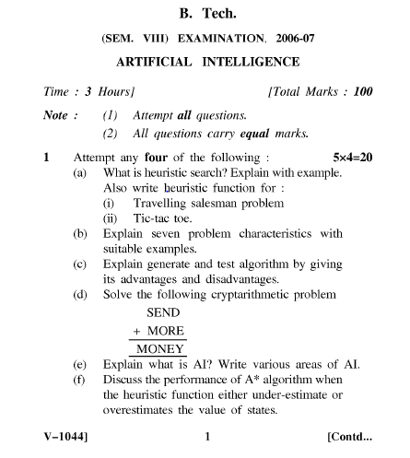
Old Question Papers
Bhawna Wadhwa ACSAI-301 AI Unit 01

Slide 36
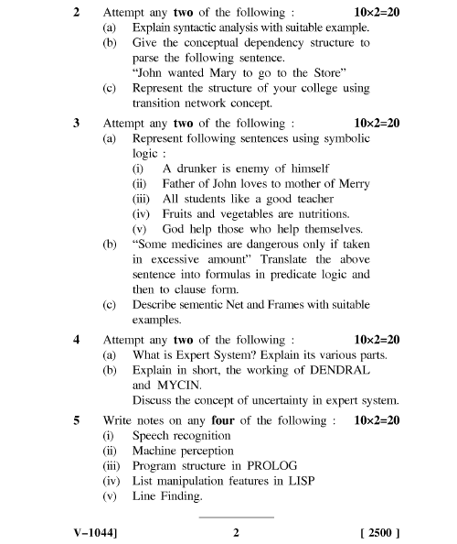
Old Question Papers
Bhawna Wadhwa ACSAI-301 AI Unit 01

Slide 37

Alka Singh ACSAI-301 AI Unit 04

